Slide 1
From Barriers to Bridges:
An ADVANCE Dialogue on Women of Color in the Academy and Forging Cross-Racial Alliances
Funding for this presentation was made possible through the National Science Foundation ADVANCE Institutional Transformation grant (#0810927) awarded to Washington State University 2008. Any opinions, findings, and conclusions or recommendations expressed in this material are those of the author(s) and do not necessarily reflect the views of the National Science Foundation.

Slide 2
Welcome to Diversity 101
The Office: What Not to DO!

Slide 3
Overview
The Foundation for the Conversation
Why Should We Care?
Defining Women of Color (WOC) and Intersectionality
Higher Education Context for WOC
ADVANCE Context for WOC
ADVANCE Implementation Mentors (AIM) Network
AIM Network WOC Allies & Partners Project
ADVANCE Programs Specific to WOC
AIM Network WOC Survey Results
Interview Results
WOC Data
Change Agents and Allies
Practice and Next Steps

Slide 4
Foundation for the Conversation

Slide 5
Why Should We Care?
Scientists should reflect US racial/ethnic demographics
Diverse groups have higher group performance (Phillips, Liljenquist, & Neale, 2009).
Cultural and social determinants of health need the attention of diverse scientists
Technological advancements are enhanced by diverse developers
Race alters the experience of gender and gender alters the experience of race (Morris, 2007).
Notes:
“Diversity in groups creates awkwardness and the need to stop this tension may lend to better problem skills in groups. Although people may feel at ease in homogenous groups, homogeneity can prevent the exchange of new ideas and stifle the intellectual workout that stems from disagreements (Kellogg Insight, 2010).”

Slide 6
An Engineering Example
Why Race Matters?
HP Face-tracking Software
Notes:
Asian American women STEM professors lowest race/ethnic tenure professor group (Burrelli, 2009).

Slide 7
Defining Women of Color (WOC)
US historical underrepresentation in STEM compared to US representation (Ong, Wright, Espinosa, & Orfield, 2011).
NSF defines WOC as African American, Native American, and Hispanic/Latina Women.
Asian women are not under-represented in STEM fields (Burrelli, 2009); however they are underrepresented in leadership.
Asian American and International women differ from White Women and WOC . This project includes data and interviews from International and Asian American women.
Notes:
Asian American women STEM professors lowest race/ethnic tenure professor group (Burrelli, 2009).

Slide 8
Intersectionality
“Intersectionality theory holds that modes of inequality, such as race, gender, and class, can combine in ways that alter the meaning and effects of one another.” (Morris, 2007)
“Race alters the very meaning and impact of gender and gender alters the very meaning and impact of race”

Slide 9
Higher Education Context:
Student Diversity Pipeline
The race/ethnicity of students planning to major in S & E has become more diverse over time (1995; 2010):
White students planning to major in S&E declined (77% to 71%)
Asian American/Asian students increased (7% to 12%)
Hispanic students increased (5% to 13%)
American Indian/Alaska Native and black students accounted for roughly 2% and 11%, respectively, of freshmen intending to major in S&E in both 1995 and 2010 (NSF, 2012)
Female students:
white first year students (31%) expressed lower intentions to major in S & E compared to Asian (38%), African American (35%), Hispanic American (38%) in 2010 (NSF, 2012).
Research on WOC in STEM has focused on undergrad women. There is a scarcity of research on WOC graduate students or faculty (Ong, 2010).

Slide 10
Higher Education:
Faculty Gender Diversity
Women account for 21% full professors, 37% associate professors and 42% of junior professors (NSF, 2012).
Faculty Race Diversity
75% of full-time faculty are White Males (Hoopes, 2013)
6% of full professors in the US are Black, Hispanic, or Native American (NSF, 2013)
4% of underrepresented minority professors are in Research I institutions (NSF, 2013)
Notes:
Women holding doctorates in Science, Engineering, and Health (SEH) account for 21% full, 37% associate, and 42% junior professors.

Slide 11
Exercise
Who do you take to lunch from the department/office?
Who are your close friends?
Who are your neighbors?
Who teaches your children, addresses your health and/or legal needs?
Notes:
The goal here is for individuals to list these individuals by race and gender. Individuals may come away from this exercise realizing that their daily life may not include a realm of diverse people.
This exercise may also be done with a set of different colored beads and clear plastic cups. Please see handout.

Slide 12
ADVANCE Context for WOC

Slide 13
AIM Network History
Initiated: ADVANCE PI meeting (Nov. 2010)
Target Audience: ADVANCE Program Coordinators/Directors (i.e., IT, PAID, Catalyst grants)
Goal: To optimize efficiency and effectiveness of national ADVANCE efforts by establishing a Community of Practice yo provide ADVANCE Program Coordinators & Directors with:
on-demand support
intra-and-inter cohort mentoring
efficient information dissemination
best/promising practices identification

Slide 14
AIM Network Objectives
Establish a listserv (Dec. 2010)
Establish a monthly meeting (Jan. 2011)
2nd Tuesday of the month (8:30 PST)
Establish a means for storing and sharing documents (Jan. 2011)
WEPAN Knowledge Center: AIM Network Interest Group

Slide 15
AIM Network Membership
Membership has continued to grow over the last 3 years…

Slide 16
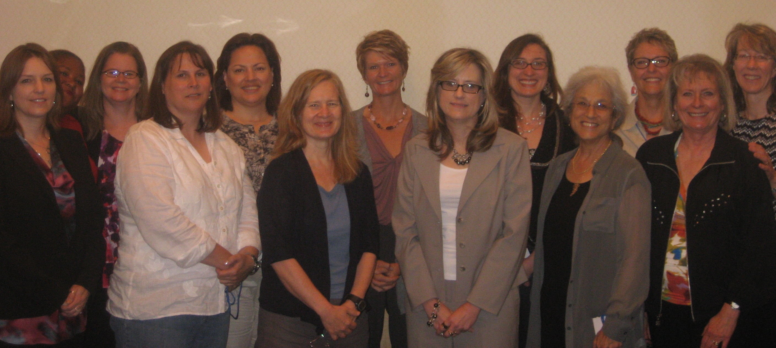
AIM Network Members
AIM Network Members at the 2011 NSF Joint Annual Meeting.

Slide 17
WOC Allies & Partners Project
ADVANCE NSF Supplemental Grant
Webinar (Nov. 1st, 2012)
Op Ed Project Training (Post ADVANCE Workshop, March 6th, 2013)
AIM Network Website Development (Aug. 1st, 2013)
WOC PowerPoint
WOC Reference List
WOC ADVANCE Data
Project Evaluation

Slide 18
WOC-Specific ADVANCE Programs
Rutgers University (2008) ADVANCE IT: Women of Color Scholars Program
Syracuse (2010) ADVANCE IT Chancellors Faculty Fellow Program
Texas A & M (2010) ADVANCE IT: Scholar Mentor Program
ADVANCE HBCU Women Faculty
University of Montana PACE (2003)ADVANCE IT: outreach to American Indian Women Scientists
Indigenous Women in Science Network

Slide 19
WOC-Specific ADVANCE Programs (Continued)
MentorNet (2010) PAID
Purdue (2008) ADVANCE IT
Howard University (2012) ADVANCE IT
Jackson State University (2010) ADVANCE IT
RIT (2012) ADVANCE IT
IWPR (2012) PAID
Other?

Slide 20
AIM Women of Color: Survey
9 question survey (Mar. 20th- June 8th, 2012)
Predominately ADVANCE IT institutions represented
Three main survey questions:
Do ADVANCE Program Coordinators/Directors have the tools to be Allies/Advocates for WOC STEM faculty ? (i.e. WOC data, knowledge of barriers and factors for success for WOC, collaborators)
What are ADVANCE programs offering for WOC?
What ADVANCE activities do Program Coordinators/Directors perceive are going well (or not so well) re: WOC?

Slide 21
AIM WOC: Survey Results
45% completion rate (i.e., 17/38)
Data collection precipitated good discussions and provided the focus for two AIM meetings
ADVANCE institutional challenges noted: WOC data not collected and/or difficult to find data, cohort related)

Slide 22
WOC Survey: Question 1
What is the % of Women of Color faculty at your institution?

Slide 23
WOC Survey: Question 2
What types of activities does your ADVANCE program offer specifically to Women of Color faculty? (please check all that apply)*
Note*: 9/17 answered this question

Slide 24
WOC Survey: Question 3
What do you perceive as barriers to success for Women of Color faculty at your institution (please check all that apply)?

Slide 25
WOC Survey: Question 4
What do you perceive as factors that promote success for Women of Color faculty at your institution (please check all that apply)?

Slide 26
WOC Survey: Rate Aspects of Your Program for WOC
 | Poor | Fair | Good | Very Good | Excellent | N/A
Data Collection | 12% (2) | 0% (0) | 6% (1) | 29% (5) | 47% (8) | 6% (1)
Promoting Success | 6% (1) | 29% (5) | 24% (4) | 12% (2) | 12% (2) | 18% (3)
Retention Efforts | 6% (1) | 29% (5) | 18% (3) | 18% (3) | 6% (1) | 24% (4)
Enhancing Climate | 6% (1) | 23% (4) | 29% (5) | 18% (3) | 6% (1) | 18% (3)
Recruitment | 24% (4) | 35% (6) | 24% (4) | 12% (2) | 0% (0) | 6% (1)
Different Issues Identified for WOC/WW | 18% (3) | 12% (2) | 47% (8) | 6% (1) | 6% (1) | 12% (2)
Notes:
Program Directors/Coordinators were asked to rate aspects of their ADVANCE program for WOC. The last category asked PD/PC’s to rate how well their programs differentiated issues faced by WOC and White Women.

Slide 27
WOC Survey: List Barriers For Asian American Women
Isolation
Implicit Cultural Biases.
“Model Minority” Stigma
Classroom Challenges
Majority ignorance of barriers faced—unintentional biases (e.g., advancement ceiling).

Slide 28
WOC Survey: List Barriers For International Women
Isolation (i.e., Few women with the same cultural issues)
Visa Issues.
Cross-cultural issues (i.e., language)
Lack of models, especially in upper levels of the academy
Dual-culture gender biases
Work-life balance extended outside of the US
Culture issues from their own country

Slide 29
WOC Survey: Comments
“Our numbers are so small it’s hard to make any comments that are of statistical significance.”
“Data collection is challenging. How do we provide the few WOC we have with a voice, while at the same time providing confidentiality?”
“Until we create a climate where WOC are successful (i.e., retained, mentored, less isolated) through active support from majority faculty, I am ambivalent about how much benefit WOC-specific programs will provide.”

Slide 30
Interviews with WOC
“My experience has revealed that my own belief that I am just as capable and competent as males, particularly white males, has determined my career success. When I doubted my capabilities then I was treated as if my capabilities were inferior. However, when I valued my capabilities and believed that I brought to the table valuable assets, then I was treated as if I had something of value. My experience also reveals that there is a culture of disrespect for those who are different.”
Notes:
This is a sample of interviews conducted with WOC STEM professors. WOC STEM professors were in biology, chemistry, and engineering departments. WOC faculty were asked what are some of the barriers to their success?

Slide 31
Interviews with WOC
“I believe the barriers to success for minority women in science is the feeling of being disconnected and the lack of appropriate role models and mentors. For me, I still feel like I am an outsider among fellow scientists, like I still have to prove myself before I will be taken seriously or be considered for opportunities for career advancement. In science there is no clear map to success, but for minority scientists, particularly women, we are less likely to even be aware of opportunities that are available. “
Notes:
This is a sample of interviews conducted with WOC STEM professors. WOC STEM professors were in biology, chemistry, and engineering departments. WOC faculty were asked what are some of the barriers to their success?

Slide 32
Interviews with WOC
“I believed that if I work hard my superior will see that and make fair decisions about my position. The truth is I need to sell myself as competent and as an asset. ”
“The leadership is made up primarily of males and I think this implicitly sends the message that females are unwanted, not valued, or not perceived as not being as capable as males. ”

Slide 33
Interviews with WOC
“…very favorable for women at the higher administration end, as this is an HBCU. Within the department of chemistry there is still the impression that it is male-dominated and certain underlying currents occasionally come up (i.e., when decisions are made, directions for department, etc.) that suggest the male faculty on board still think this is a male dominated field.”

Slide 34
Interviews with WOC
“Minority women may have more of a family responsibility. If our family is relying on our paycheck then we may not want to be considered "trouble makers" by not accepting the disrespect and disregard from the administration and colleagues.”
Other barriers experienced include the lack of:
Mentoring
Resources
Collaboration

Slide 35
Women of Color Faculty Data

Slide 36
B.S.’s Awarded to Women by Field and Race/Ethnicity (2010)
National Science Foundation, National Center for Science and Engineering Statistics, Survey of Doctorate Recipients, 2010.
Notes:
CS=computer science

Slide 37
M.S.’s Awarded to Women by Field and Race/Ethnicity (2010)
National Science Foundation, National Center for Science and Engineering Statistics, Survey of Doctorate Recipients, 2010.
3,213
2,409

Slide 38
Ph.D.’s Awarded to Women by Field and Racial/Ethnicity (2010)
National Science Foundation, National Center for Science and Engineering Statistics, Survey of Doctorate Recipients, 2010.
D = suppressed to avoid disclosure of confidential information

Slide 39
Total S & E Faculty by Sex (2010)
National Science Foundation, National Center for Science and Engineering Statistics, Survey of Doctorate Recipients, 2010.

Slide 40
S&E Faculty Rank by Sex and Race/ Ethnicity (2010)
National Science Foundation, National Center for Science and Engineering Statistics, Survey of Doctorate Recipients, 2010.
 | Assistant | Associate | Full
White | 13,000—Female (18,100)—Male | 12,300 (24,200) | 12,300 (49,600)
Black | 1000 (1,200) | 800 (1,400) | 500 (1,100)
Hispanic | 1,100 (1,500) | 900 (1,300) | 400 (2,000)
Asian | 3,400 (6,300) | 2,000 (4,400) | 1,100 (7,000)
Native American | <100 <100 | 100 <100 | <100 100
Notes:
()=male professors, <100=suppressed to avoid disclosure of confidential information. Please note that at every level male professors have a higher number of faculty representatives, particularly at the full professor level.

Slide 41
Women Assistant Professors by Field (2010)
National Science Foundation, National Center for Science and Engineering Statistics, Survey of Doctorate Recipients, 2010.
4,200
D = suppressed to avoid disclosure of confidential information
*= value < 50

Slide 42
Women Full Professors by Field (2010)
National Science Foundation, National Center for Science and Engineering Statistics, Survey of Doctorate Recipients, 2010.
3,700
D = suppressed to avoid disclosure of confidential information

Slide 43
Change Agents and Allies

Slide 44
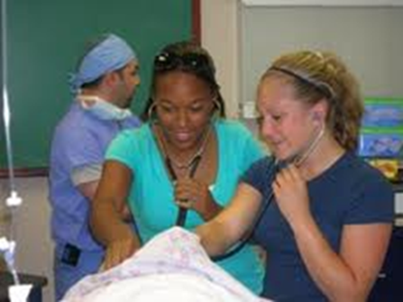
Advocates and Allies
Little “a” advocate/ally; and big “A” Advocate/Ally
Who’s invited to the “table” and who isn’t?
Opportunities for Alliance Building (Houston, 2007, AACU)
Invisibility and Silencing
Underestimating
Shifting Criteria
Notes:
PD/PC’s may not always be able to push for major change (Big C) but may be able to do little things to advance change (Little C). For example, being aware of who’s at the table and who is not at the table and looking for opportunities for alliance building and hindrances to alliance (see Survey Cont: http://www.aacu.org/ocww/volume36_1/feature.cfm?section=1)

Slide 45
White Women Allies
Recognize the impact of race and gender
Acknowledge privilege
Interrupt hostile behavior and micro-aggressions
Are conscious about who’s at the table and not present in the decision making process

Slide 46
Women of Color Allies
Dace (2012)
Don’t hold on to old wounds
Be open to alliances
Openly acknowledge and embrace white women allies

Slide 47
Talking About Race
Tim Wise: How Whites Talk About Race (2 minutes)
Notes:
A less than 2-minute Tim Wise you tube video details how white people talk about race.

Slide 48
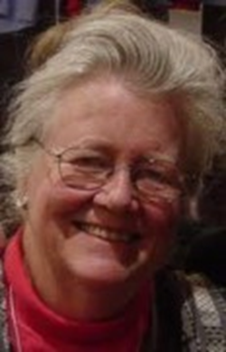
“Whites are taught to think of their lives as morally neutral, normative, and average, and also ideal, so that when we work to benefit others, this is seen as work which will allow ‘them’ to be more like ‘us.’”
Peggy McIntosh, White Privilege: Unpacking the Invisible Knapsack

Slide 49
Practice and Next Steps

Slide 50
Think-Pair-Share Exercise
Think, discuss with partner (ideally a person of a different race or ethnicity) & share with the broader group:
What stops us from having race/ intersectionality conversations?
How can we facilitate these conversations?
What does racism look like in your department (or maybe, more broadly, in the academy?)
When recruiting faculty we are always seeking “the best.” How is “best” defined and how is the answer ultimately a manifestation of a privileged majority?
What are “action steps” for you as a change agent and/or ally?

Slide 51
Recommended Readings
Dace, K. (2012). Unlikely Allies in the Academy: Women of Color and White Women in Conversation. New York, NY: Routledge.
Houston, M. (2007). Communicating as a Cross-cultural Ally. AACU.
McIntosh, P. (1988). Unpacking the Knapsack of White Privilege.
MIT (2010): A Report on the Initiative for Faculty Race and Diversity.
Ong, M. & et. al (2010): Inside the Double Bind: A synthesis of empirical research on WOC in STEM.
Trower, C. & Chat, R. (March-April 2002) Faculty Diversity: Too little for too long. Harvard Magazine.
Turner, C. (2002). Women of Color in Academe: Living with Multiple Marginality. Journal of Higher Education, 73 (1).

Slide 52
Learn about the AIM Network or the WOC Allies & Partners Project
AIM Network/WOC Allies & Partners Project
Gretal Leibnitz, Ph.D. ADVANCEAIMNetwork@gmail.com
WOC Allies & Partners Project
Ming Shi Trammel, Ph.D.
Formerly ADVANCE NC State University
mingtrammel@gmail.com

